Slide 1
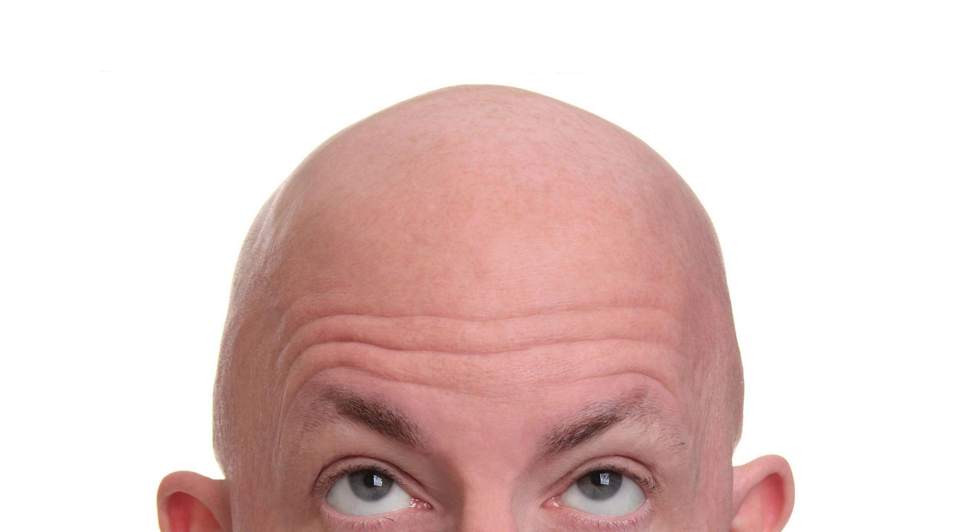
Male Baldness
Kyungjin Cho

Slide 2
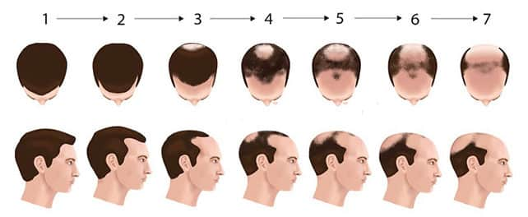
Definition of Baldness
Male Pattern of Baldness (MPB)
aka. Androgenetic Alopecia
It is an age-related condition that characterizes hair thinning and loss
80% of European men are affected by MPB
Balding process is highly Patterned:

Slide 3

What Makes a Person Bald?
Gender
Age
Stress
Level
Medical
Condition
Hairstyle
Radiation
Sleep Pattern
Family
History

Slide 4
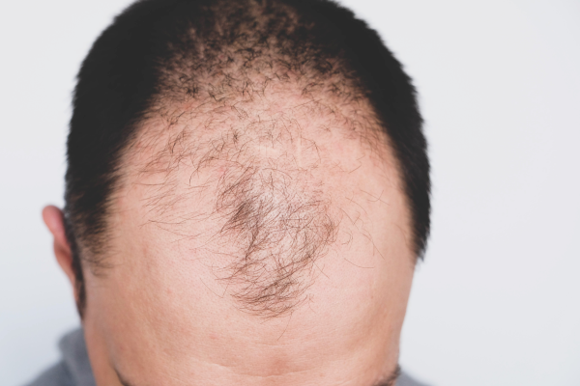
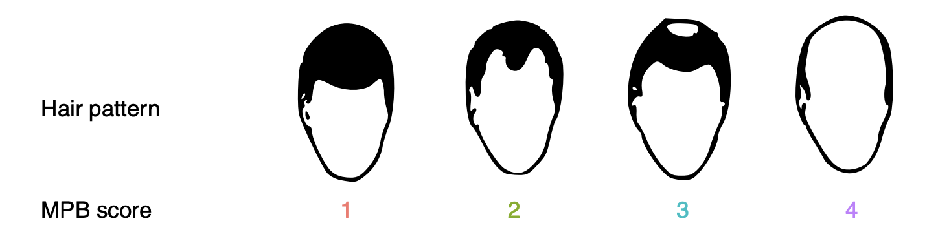
About this Project
Male Pattern Baldness(MPB)
Study from UK Biobank
Sample of 205,327 European Males
MPB is Sex-limited, Age-related
Study male participant, 40 to 73 years old

Slide 5
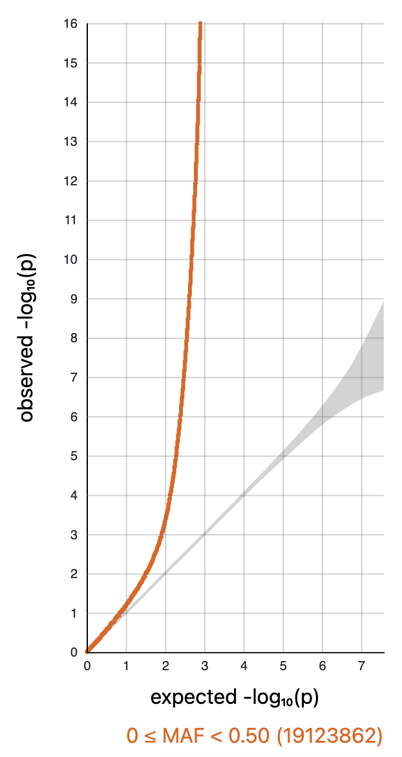
Q-Q Plot
QQ Plot is not diagonal with the existence of “tail”
The line is skewed, rather exponential
We will not observe a uniform distribution of p-value
Further analysis strategy needed
Notes:
under pure drift, we expect LD to have no relationship to differences in allele frequencies between populations

Slide 6
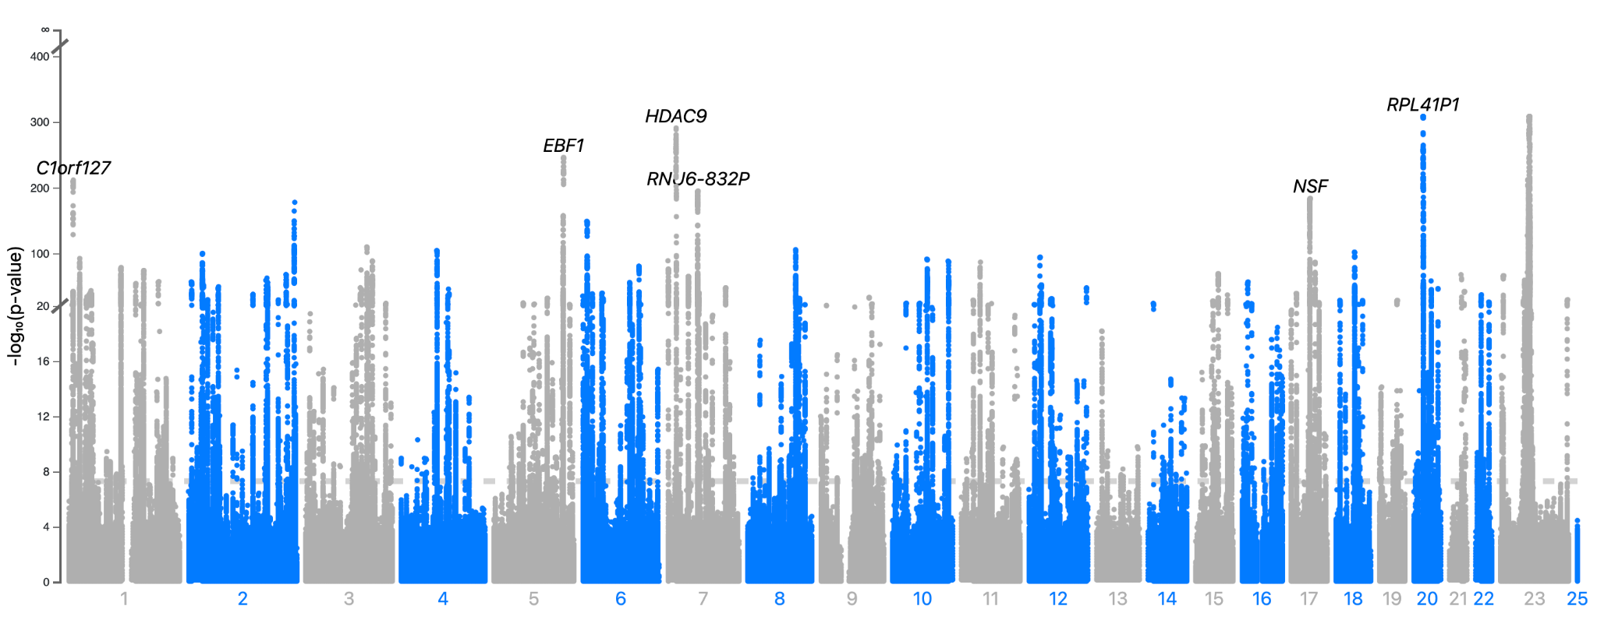
Manhattan Plot

Slide 7
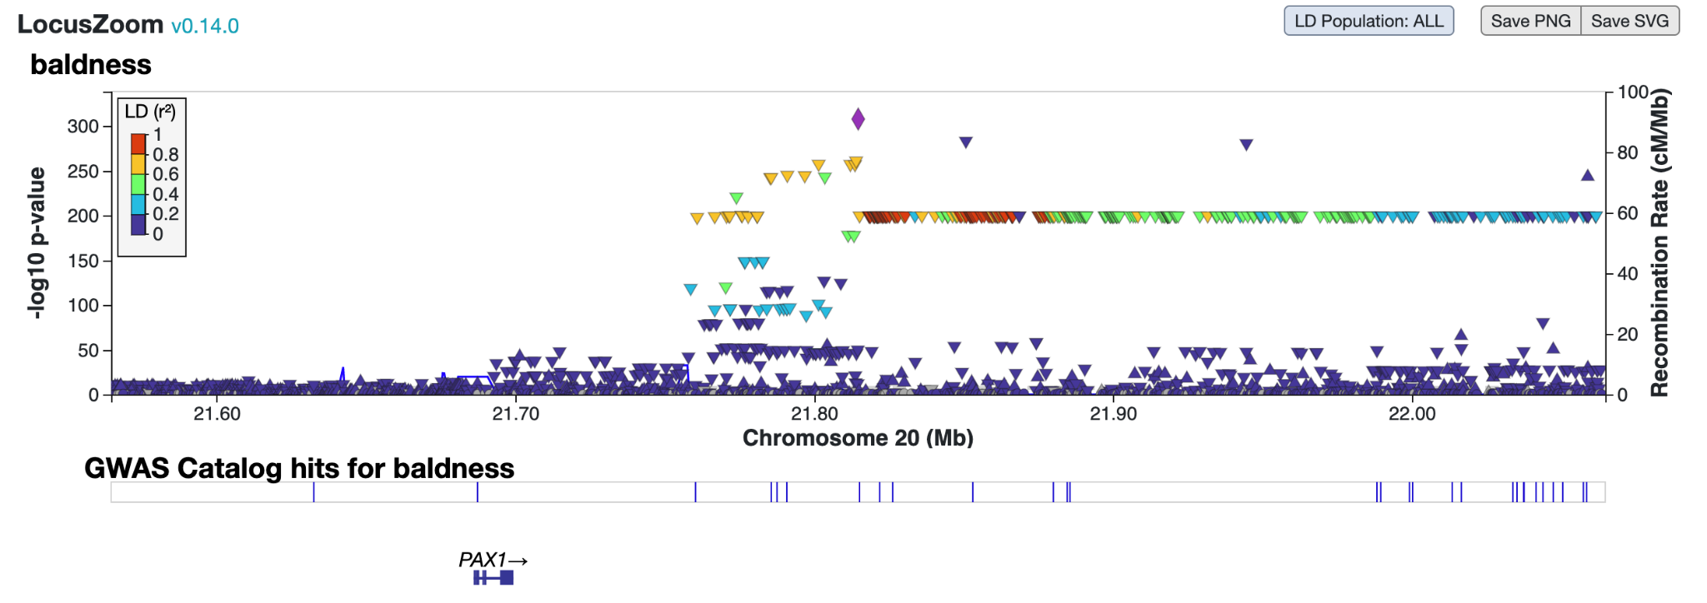
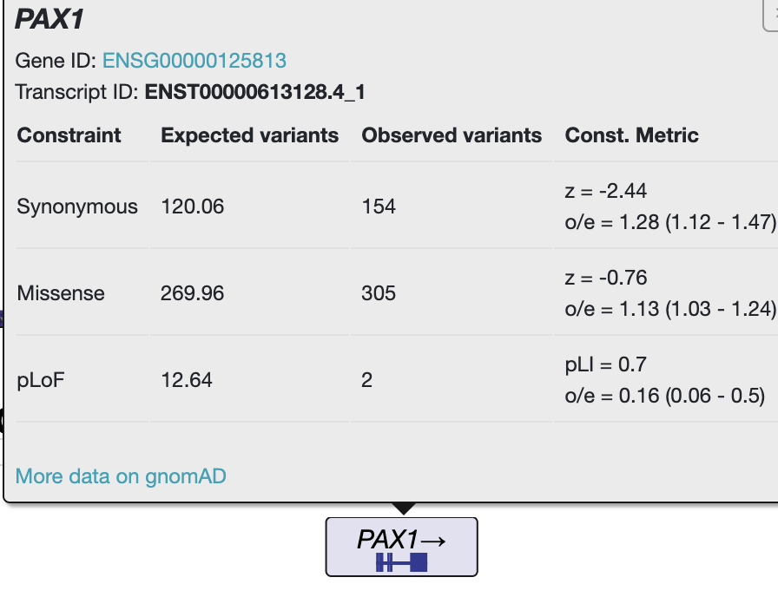
LocusZoom Plot

Slide 8
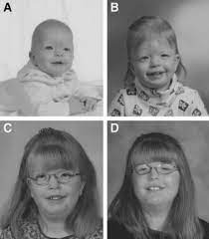
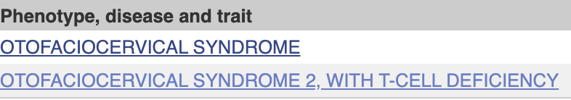
LocusZoom Plot
Related phenotypes, diseases and trait of PAX1:
Developmental Defect Characterized by Distinct Facial Feature

Slide 9
LDSC - Intercept and Heritability Results
Intercept:
 | Point Estimate | Standard Error | P-value
Value | 1.227 | 0.020 | < 0.05
Heritability:
 | Point Estimate | Standard Error | P-value
Value | 0.324 | 0.027 | < 0.001

Slide 10
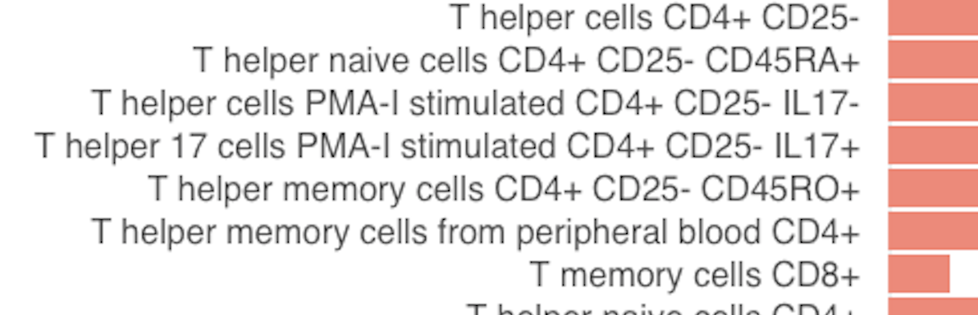
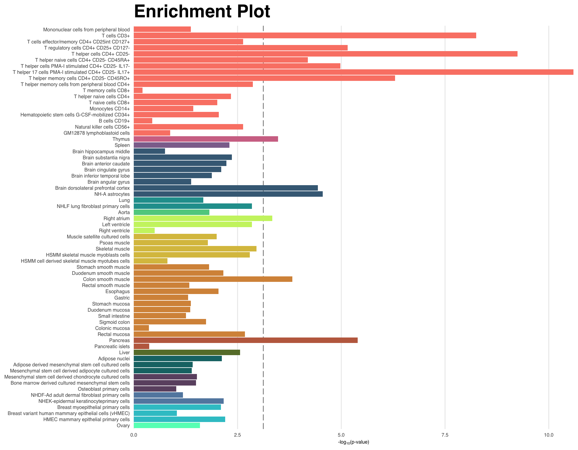
Heritability Enrichment Plot - Most Important
T-helper 17 Cells / General T cells:
Plays role in pathogenesis of autoimmune disease
Most autoimmune diseases can be particularly associated with hair loss such as, alopecia, lupus, Hashimoto’s, psoriasis, and Crohn’s Disease/ulcerative colitis.

Slide 11
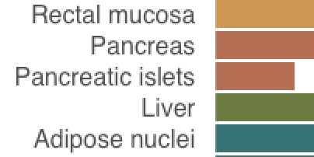
Heritability Enrichment Plot - 2nd Most Important
Pancreatic Cells:
Plays role in producing and transporting chemicals that exits the body through the digestive system
Lot of diseases, cancers or disorders of pancrea causes hair loss as a side effect

Slide 12
5 Different Other GWAS
GWAS | Reasons of Interest
Cannabis Use Disorder | Misuse of drugs can cause a lot of side effects to our body!
Smoking Initiation | Smoking is always considered unhealthy
Daytime Napping | Napping might relieve the stress
Loneliness | Loneliness lead to mental health problem and might be correlated with hair loss
Household Income | Higher income people are likely to consume better quality of foods

Slide 13
Global Genetic Correlation
 | SMOKE | CANNABIS | LONELINESS | NAP | INCOME
BALDNESS | +0.030 | -0.006 | -0.017 | +0.041 | -0.004
All other five GWAS were NOT significantly correlated with baldness
WHY?
Baldness, as mentioned in the paper, are closely related to gender, bone mineral density and pancreatic cell function
None of the 5 GWAS are closely related to three categories

Slide 14
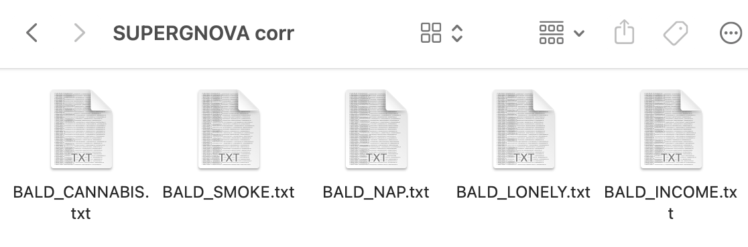
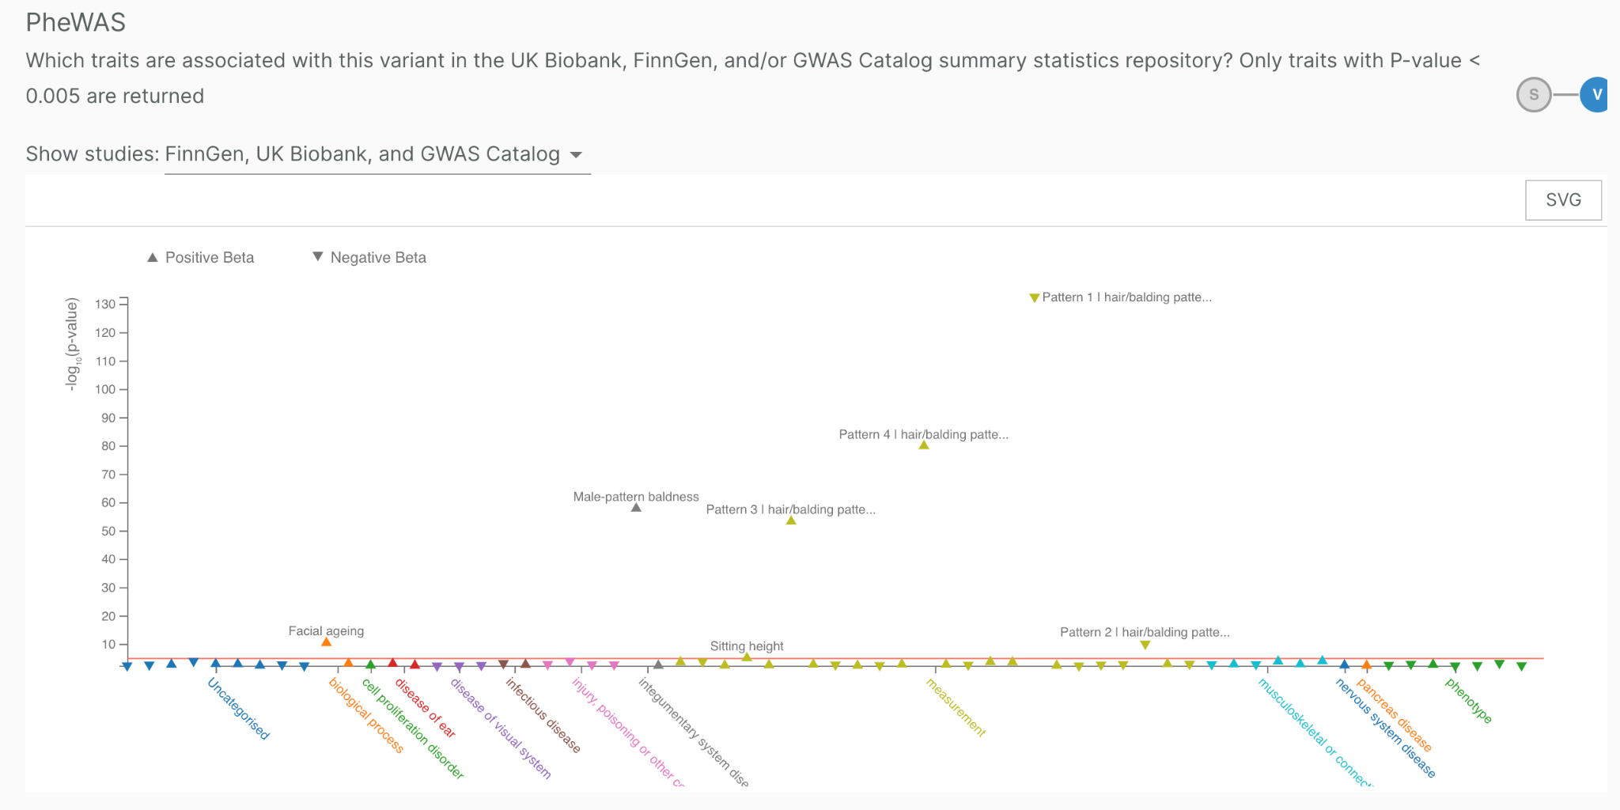

Local Genetic Correlation (SUPERGNOVA)
CHR 20 was highly correlated with baldness and 5 other GWAS
PreWAS shows that the SNP rs6047658 is highly related to balding pattern with p-value of 6.3e-172

Slide 15
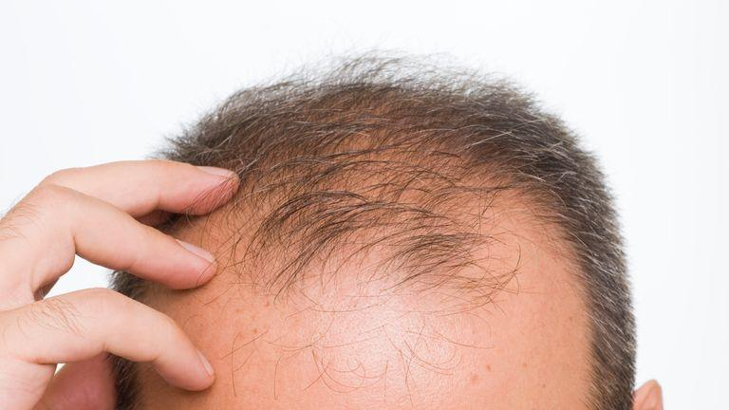
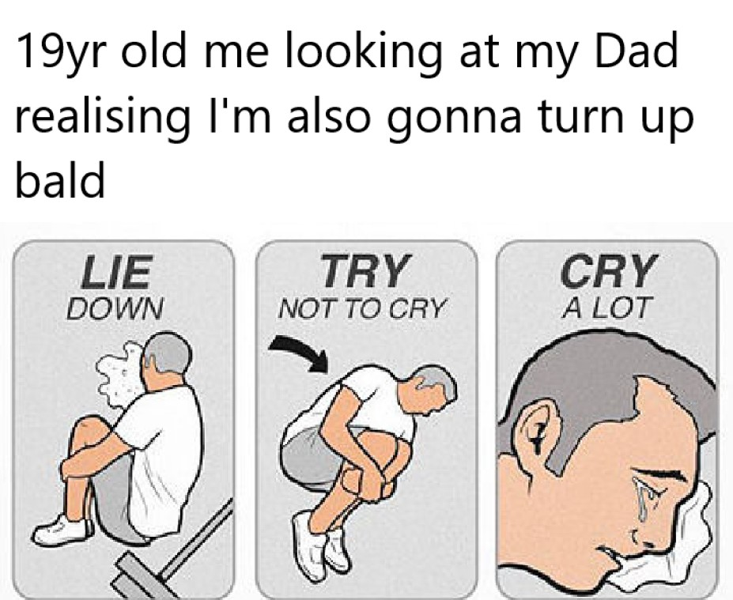
So Start Blaming
Your Dad if he is Bald!
Thank You

